Slide 1
Design Pattern - Strategy
Sourav & Shubham

Slide 2
What is Strategy
Define a family of algorithms, encapsulate each one, and make them interchangeable. Strategy lets the algorithm vary independently from clients that use it.

Slide 3
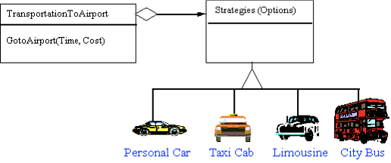
Real Life Example

Slide 4
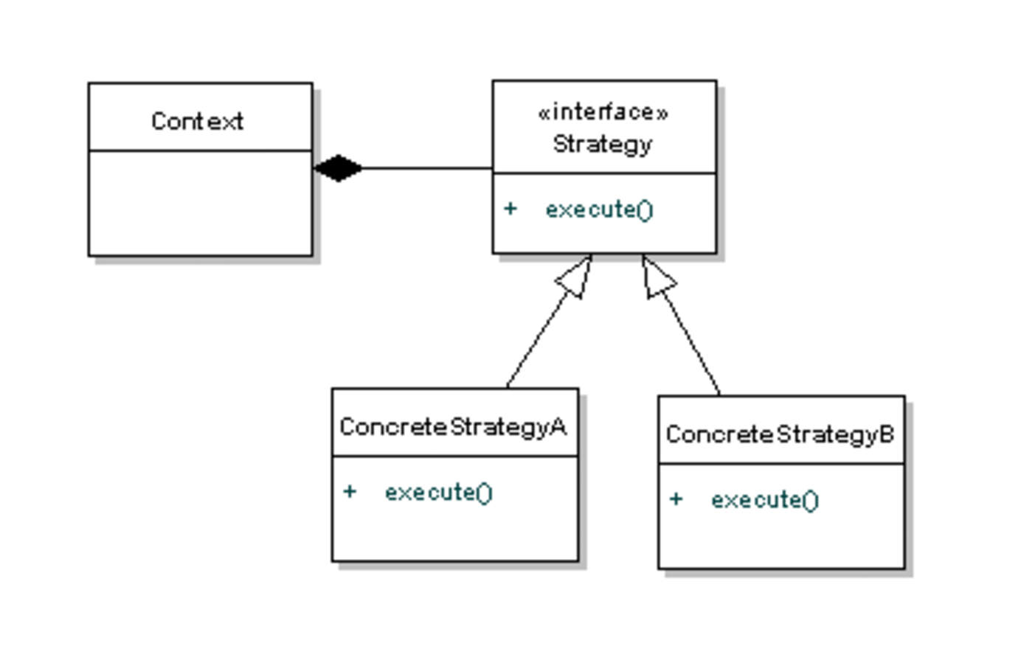
Structure

Slide 5
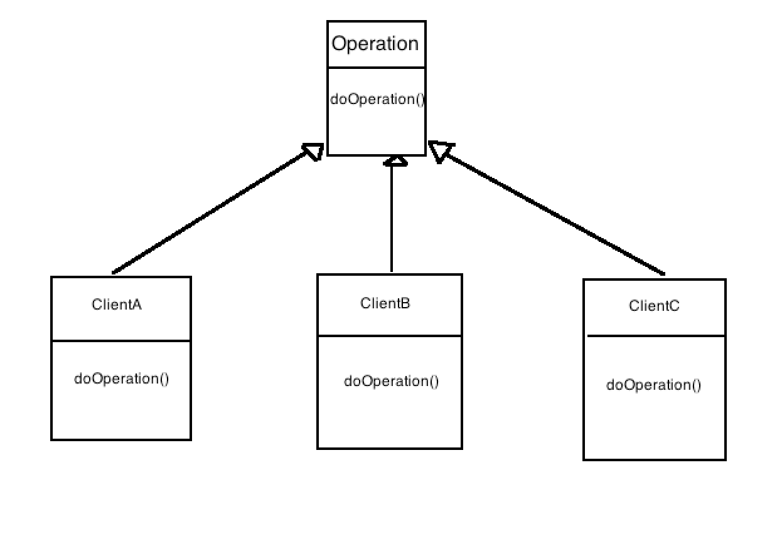
Problem

Slide 6
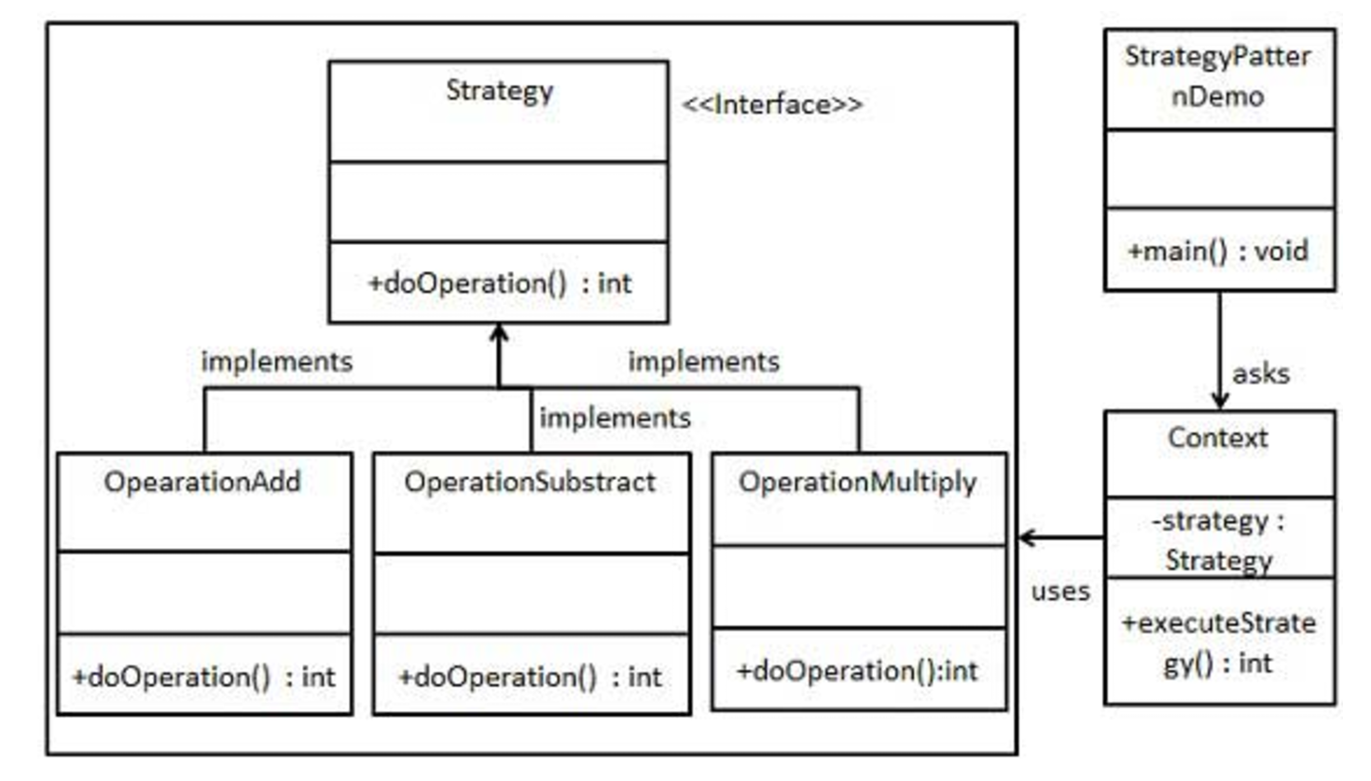
Example - Our structure

Slide 7
Step 1
Create an interface
public interface Strategy { public int doOperation(int num1, int num2); }

Slide 8
Step 2- Implementing the Interface
public class OperationAdd implements Strategy{ @Override public int doOperation(int num1, int num2) { return num1 + num2; } }
public class OperationSubstract implements Strategy{ @Override public int doOperation(int num1, int num2) { return num1 - num2; } }
public class OperationMultiply implements Strategy{ @Override public int doOperation(int num1, int num2) { return num1 * num2; } }

Slide 9
Step 3 - Context Class
public class Context { private Strategy strategy; public Context(Strategy strategy){ this.strategy = strategy; } public int executeStrategy(int num1, int num2){ return strategy.doOperation(num1, num2); } }

Slide 10
Step 4 - Client
public class StrategyPatternDemo { public static void main(String[] args) { Context context = new Context(new OperationAdd()); System.out.println("10 + 5 = " + context.executeStrategy(10, 5)); context = new Context(new OperationSubstract()); System.out.println("10 - 5 = " + context.executeStrategy(10, 5)); context = new Context(new OperationMultiply()); System.out.println("10 * 5 = " + context.executeStrategy(10, 5)); } }

Slide 11

REAL LIFE Examples
File file = getFile();
Cipher c = CipherFactory.getCipher( file.size() );
c.performAction();
Two types of Cipher Strategies we are going to use based on file size -
In Memory Cipher Strategy
Swap to Disk Cipher Strategy

Slide 12
// implementations:
interface Cipher {
public void performAction();
}
class InMemoryCipherStrategy implements Cipher {
public void performAction() { // load in byte[] .... }
}
class SwaptToDiskCipher implements Cipher {
public void performAction() { // swapt partial results to file. }
}

Slide 13
GraphStrategy graphStrategy;
if (phoneBrowser == true) {
graphStrategy = new SmallGraphStrategy();
}
else {
graphStrategy = new BigGraphStrategy();
}
interface GraphStrategy {
Image renderGraph(Data graphData);
}
class BigGraphStrategy implements GraphStrategy { ... }
class SmallGraphStrategy implements GraphStrategy { ... }

Slide 14
Thank you

